Slide 1
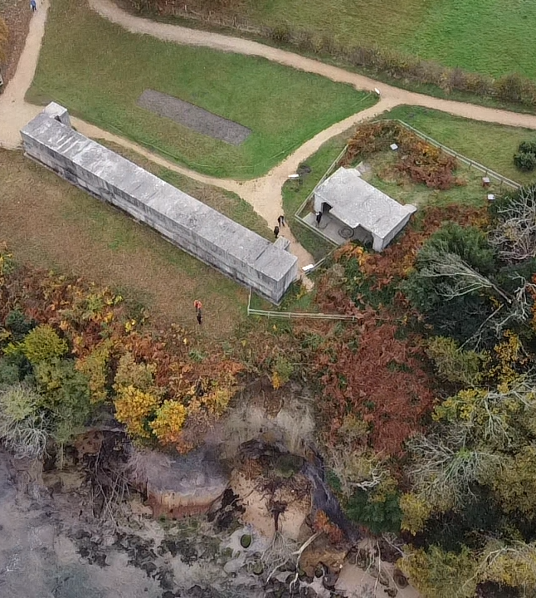
For caretakers of historic and beautiful places
How to use this Climate Change Adaptation Guidance

Slide 2
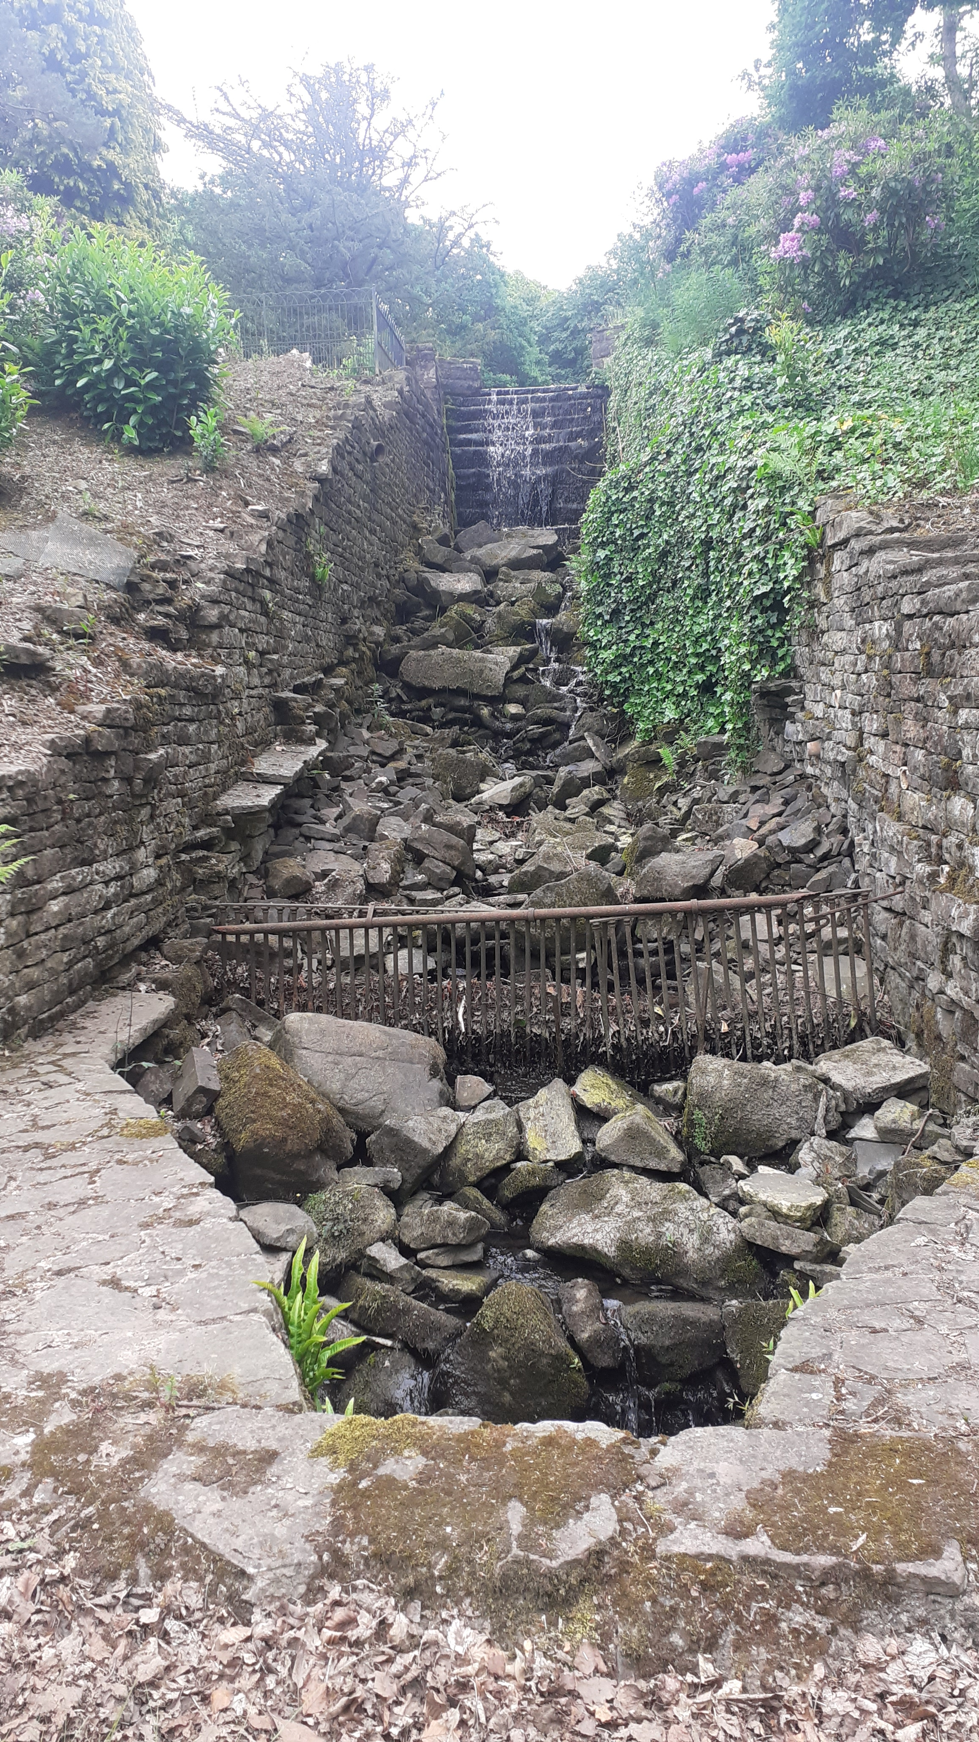
Basic navigation
This manual is designed to be easily navigable and while our places and assets and how people interact with them are all connected, we (as managers and caretakers looking after such sites) need to be able to deal with climate change adaptation in manageable pieces.
The guidance is divided by asset and activity type based on the National Trust’s operations, consultancy and central teams. While not directly transferable to all other similar organisations and places, we hope this guidance (developed in collaboration with support from Historic England, Historic Environment Scotland, Cadw, Department for Communities Northern Ireland, National Trust Scotland and English Heritage Trust) will contain useful and practical information around options, thresholds and methods for decision-making around climate adaptation pathways for all similar organisations.
Detailed sections within chapters are broken down by primary asset and activity types and while the same detailed sections can be found under more than one chapter, these link through to the same published guidance extract from the overall manual.
Each detailed guidance section is broken down into: -
background information on that asset/activity
why it matters that we consider this asset/activity in the context of climate hazards
a table of hazards, impacts and potential options
detail on adaptation measures and potential thresholds for a change in approach
a worked example of the range of adaptive pathways for that asset/activity
case studies and other useful information (signposting, references, etc.)
Each chapter also has an introductory section explaining the overarching impacts of climate change on this asset/activity, priorities as we perceive them at our places, and key examples.
The guidance is not intended to be detailed, technical instruction, but is aimed at the practitioner (operations manager, climate adviser, generalist) who is faced with taking decisions around looking after a place in the face of climate hazards and uncertainty. It has been developed with advice from the four UK government and advisory agencies for heritage: Historic Environment Scotland, Historic England, Cadw and Department for Communities, Northern Ireland. Further advice and case studies have been contributed by English Heritage Trust and National Trust Scotland.
Lyme Park, National Trust © National Trust Images/Imogen Wood

Slide 3
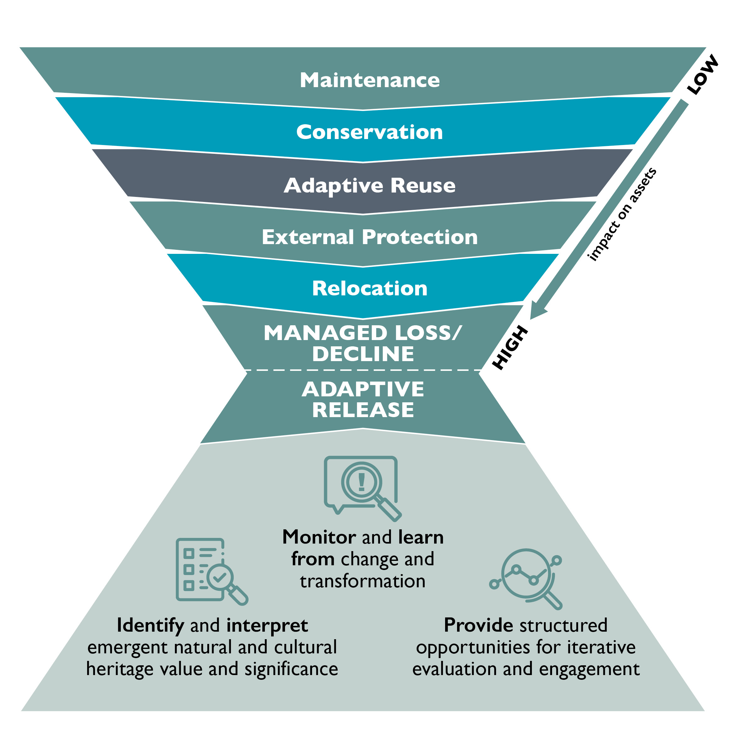
How to respond to hazards
As well as providing site managers and decision-makers with a suite of options for adapting to climate hazards (resist, accept, direct a change), this guidance aims to help with highlighting when and why a response may diverge from the current approach to a different one.
Choices and change for our significant places generally follow the inverted pyramid of the Adaptive Release diagram opposite, but triggers for change need to be grounded in best practice thresholds for change. These are likely to be bespoke to a site depending on multiple drivers and factors associated with an asset’s composition, context and use, but utilising a dynamic pathways approach to forward plan how and when a change may be triggered can help formulate long-term conservation planning and principles for a site, as well as target condition/state based on the inevitability of climate change and impacts.
In this simple example, a footpath in a designed landscape on a principal visitor route is adequate until compounding pressures for change trigger a different approach to that asset’s management:
Maintenance
The path is satisfactory as it is and simply requires occasional pothole repairs, vegetation clearance and surface washing; drains also need to be cleared out alongside the path. The threshold for change may be related to: aesthetic of overall patchwork from maintenance, lack of durability of material to shrink-swell impacts, number of health and safety incidents associated with distorted path surfacing.
Conservation
As a result of more frequent wet and dry periods, shrink-swell incidents distort surfaces to the point where health and safety is impacted and the additional need from usability around access and capacity means the path surface is changed and its area widened.
Before any action is taken, a level of knowledge of the existing systems is required in order to understand what the problem is; where have things gone wrong? What makes this asset special in its context? This information will help to inform the method and option of the change in approach.
For a building, a coastal asset or an asset more interconnected with the natural environment like a woodland or reservoir, the change in response is likely to be more complex and follow a number of different pathway options.
Adaptation response options: from maintenance to adaptive release
The outputs from collaborative research with Historic England, National Trust and Exeter University on how to manage sites in a more holistic and sustainable manner that demonstrates the regular option of maintenance at the top of the inverted pyramid, and the infrequent option of Adaptive Release can be represented in the diagram below.¹
¹ DeSilvey, Fredheim, Fluck, Hails, Harrison, Samuel & Blundell

Slide 4
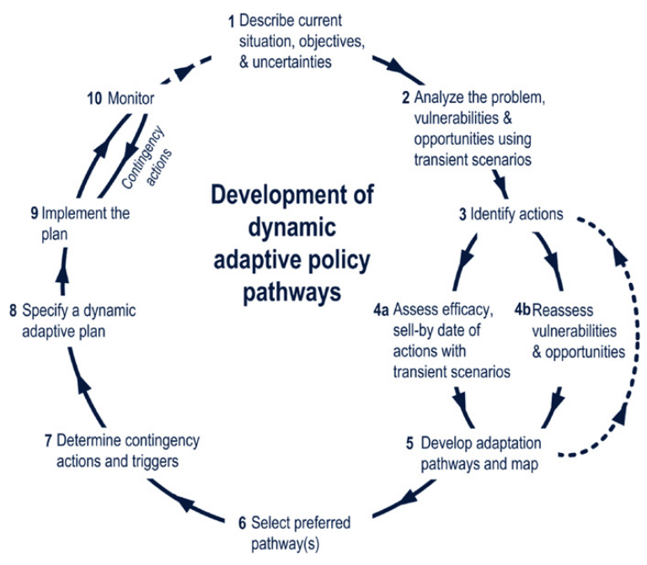
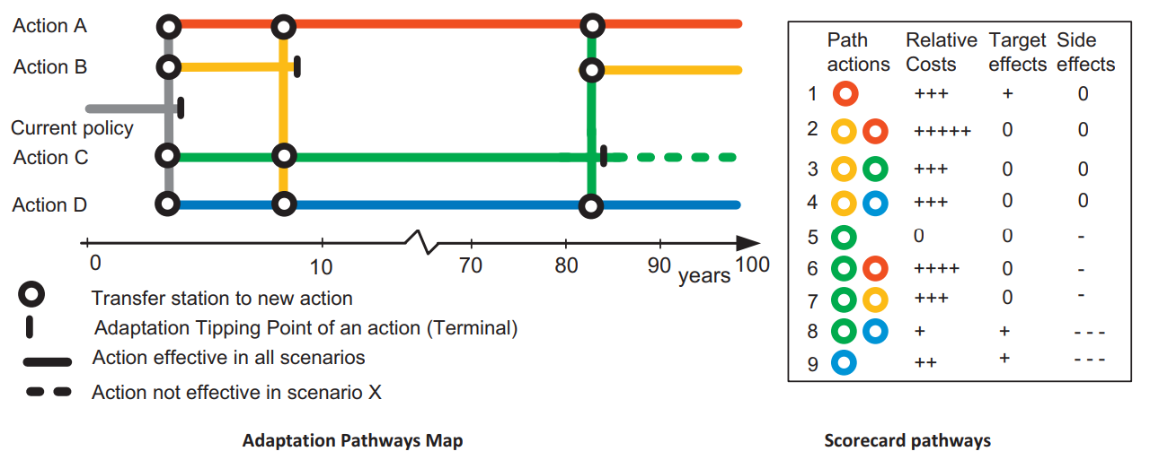
Methods for developing pathways
Several examples exist for pathway planning and this can be done from either end of the options scale (referring back to the Adaptive Release pyramid).
To develop options, a multi-disciplinary team should consider the acceptable outcomes for an asset, and the tipping point based on the pattern book and list given in the detailed section of the adaptation manual chapters to arrive at an agreed pathway. These lists are not exhaustive and there are likely to be further options for change in each context. This should be a continual review process, with checks in place to determine when thresholds are reached. If statutory protections apply, we recommend involving relevant stakeholders in that pathway planning process. Once all options for pathways are identified, a cost-benefit analysis of different pathways can be tabulated and analysed to help arrive at a preferred pathway approach.
An alternative method to the dynamic pathways approach is that utilised by UCL’s Climate Action Unit, which asks the operators and decision-makers to think of the most extreme/worse case scenario option/outcome for an asset/activity and work backwards along the thresholds for change and less extreme options/outcomes until you form a pathway and arrive at the current state of action/inaction.
Dynamic pathways: Tipping points
In this example, tipping points occur when the current/proposed policy ceases to be possible/effective based on impacts of risk and/or time. The lines representing the potential pathway are either whole (action effective in all scenarios) or dashed (action potentially ineffective based on other pathway scenarios).² The key with adaptive pathway planning is to avoid being locked in to an irreversible course of action that would prevent the exploration of alternative pathways in response to an uncertain future.
² Dynamic Adaptive Pathways Approach (Haasnoot, Kwakkel, Walker & Ter Maat)

Slide 5

Communicating change
The National Trust Climate Change Programme has been structured to address the technical aspects of climate action through our climate RACE:
R – reduce carbon emissions and carbon equivalents
A – adapt to climate hazards and build resilience into our beautiful and historic places by understanding measures and thresholds for change
C – capture carbon through more of our land which we will achieve through land use changes, tree planting and restoring our peatlands
E – engage people in the conversation to provide permission and agency, and raise awareness in ways relevant to our members, supporters, staff and volunteers.
The latter of these is key when driving change in philosophy of approach to conservation. People find climate data difficult to engage with and tend to be put off by what might be perceived as extreme views and a focus on environment, rather than recognition that these hazards have the potential to affect everyone and everything.
The National Trust is currently investigating and trialling different approaches to communicate change that comes with climate adaptation to the people and users of places which are impacted. Some change is incremental and almost goes unnoticed, while other changes come in waves and can shock people through their impacts (particularly when these are land form shifts such as cliff collapses, land slides, subsidence events and large-scale storm throw/damage).
We are currently conducting research at our places on the psychology of change and how decision-making is impacted by the uncertainty of climate change, and that this can often cause operational paralysis for properties in care where the change is virtually undetectable and where regulatory requirements mean that a like for like replacement after climate impacts leaves little room for interpretation or adaptation that diverts from the “resist” approach.
Other initiatives for communicating change directly at properties have included spaces for visitors to contribute their concerns and understanding around climate issues, to engaging climate “take overs” where a venue (such as a café or pub) is themed around climate adaptation for a week and the space is fitted out with interpretation and live experts with whom customers can engage to discuss climate issues and how they may be impacted, in the comfort of a friendly and relaxing space.
COP26 Conference Centre, Glasgow 2021 © National Trust Images/Imogen Wood

Slide 6
Glossary of terms
Aspect – an feature/asset or activity (eg monument, building, habitat, visitors, commercial activity).
Climate Factor – this is the metrological term for the climatic aspect of climate change (e.g. rain (precipitation), wind, temperature).
Climate liability – output from the exposure exercise as ranked risk and / or prioritised list of climate challenges to develop adaptation approaches to mitigate and or change an aspect’s function/ feature/ existence.
Exposure - the exposure level is an extrapolation of the overall vulnerability of aspects multiplied by the level of potential impact from the hazard factor, multiplied by the significance of the aspect.
Hazard Factor – is a singular or combination of climate factors and /or the interaction of other aspects (e.g. soil, riverbed, geomorphology). Storm, for example, is a combination of wind and rainfall climate factors beyond certain limits (mm per hour and metres per second): this equals a storm hazard.
Hazard Map – the hazard factor fixed to a place. The National Trust is currently using 65km² hexagrid mapping for England, Wales and Northern Ireland. The hazard factor is filtered to the hexagrid.
Impact – is the level of change that the hazard factor inflicts on an aspect (everything from mild or none to complete loss). For example, income drop from less visitors to a complete loss of a village on the coast as a result of coastal erosion.
Significance – how important is the aspect to the core purpose of the National Trust. This is measured as the sum of an asset’s values (aesthetic, evidential, value to people and historical value, as well as nature value).
Threshold – the trigger point at which the agree approach is no longer viable/working. This does not have to be related to climate hazards and may be concerned with maintenance cost, health and safety or other operational considerations.
Vulnerability – is the susceptibility of an aspect to the hazard (e.g. heat and visitors, flood and monument). Factors such as current management and an aspect’s condition are important multipliers here to the degree of an aspect’s vulnerability.

